Slide 1
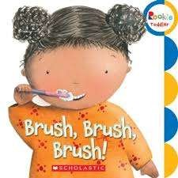
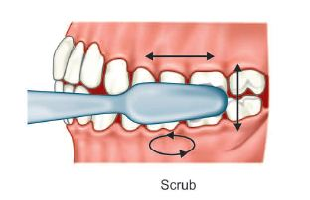
Methods of tooth brushing
SCRUB
Bristle placement: horizontal on gingival margin
Motion :anterior posterior direction

Slide 2
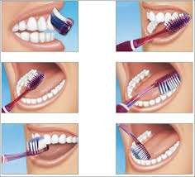
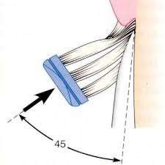
BASS
Bristle placement: apical towards gingiva into sulcus at 45degree of tooth surface
Motion :short back & forth vibratory motion while bristles remain in sulcus

Slide 3
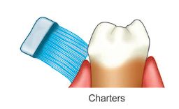
Charters
Bristle placement: coronally 45degree sides of bristle half on teeth and half on gingiva
Motion: small circular motion with apical movement

Slide 4
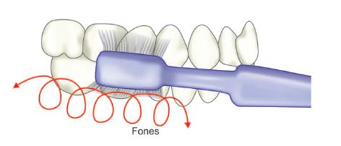
Fones
Bristle placement: perpendicular to tooth
Motion :with teeth in occlusion ,move brush in rotatory motion

Slide 5
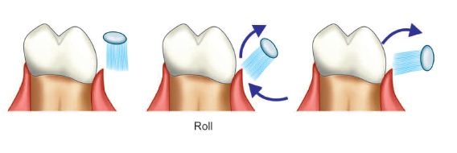
Roll
Bristle placement:apically ;parallel to tooth and then over tooth surface
Advantage
Good gingival stimulation
Disadvantage
Doesn’t clean sulcus

Slide 6
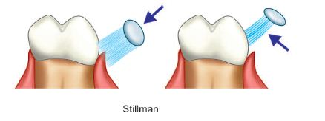
Stillmans
Bristle placement :on buccal and lingual apically at an oblique angle to long axis of tooth

Slide 7
Modified stillmans
Bristle placement: pointing apically at an angle of 45 degree to tooth surface
Motion: apply pressure as in stillmans method but vibrate brush also movie occlussaly
Advantage
Good gingival stimulation Easy to master

Slide 8
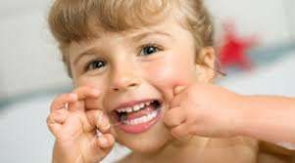
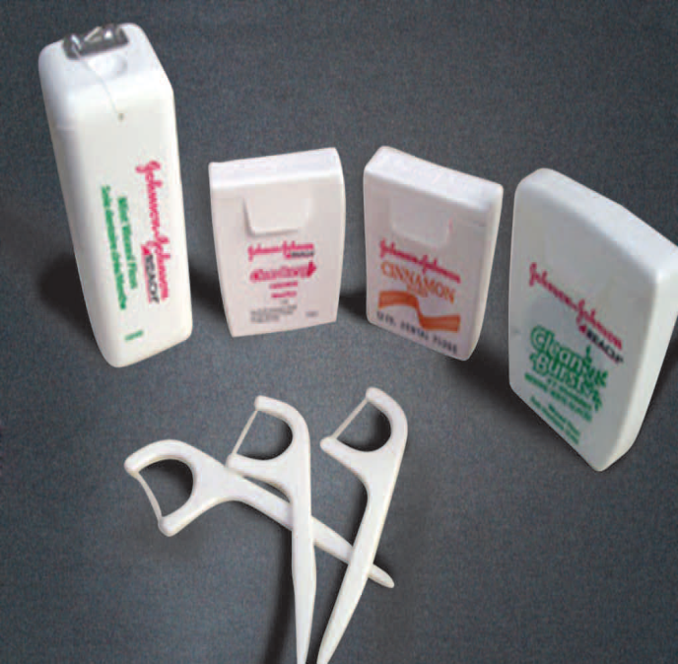
Dental floss
INTERDENTAL CLEANING AIDS
First paper - published by Parmly in 1819
1882 codman and shurtuff - 1st commercial floss made of silk .
Dr Charles C Bass - recommended nylon floss is superior to silk
Johnson and Johnson Company - first to patent dental floss
Floss constructed with help of individual filament 2 to 3 D thick.
Types
Twisted and non twisted
Banded and non banded
Thin and thick
Microfilament and macrofilament

Slide 9
Type I – unbonded dental floss compossed of yarn having no additives
Type II –bonded dental floss composed of yarn having no additives other than binding agent or agent of cosmetic performance
Type III- bonded or unbonded having drug for therapeutic usage
Notes:
According to ADA specification:

Slide 10
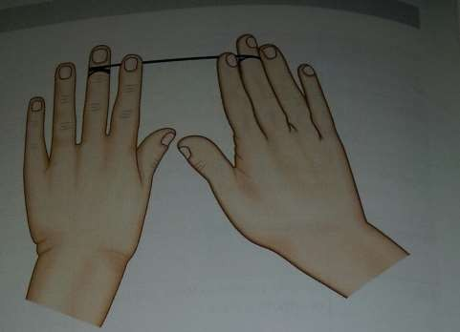
Technique
String floss method

Slide 11
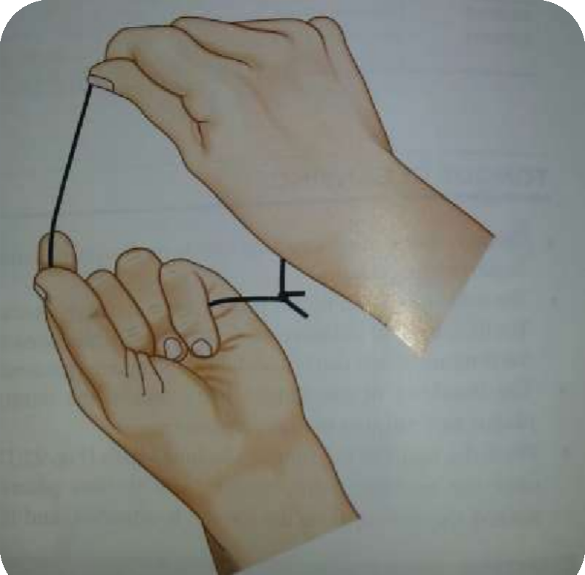
Circle floss method

Slide 12
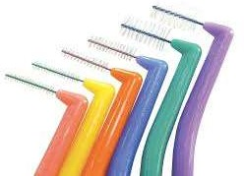
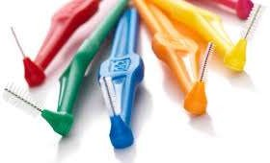
Interproximal brushes
Cone shaped brushes made of bristles mounted on handle ,single tufted brushes or small conical brushes.
Cleaning interdental spaces
Inserted interproximally and activated in short back and forth strokes in between teeth.

Slide 13
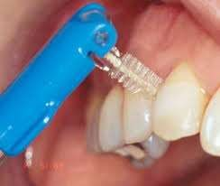
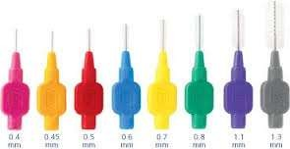
For best cleaning efficiency the diameter of brush should be slightly larger than gingival embressure.
Single tufted more effective on lingual surface of mandibular molar and premolar

Slide 14
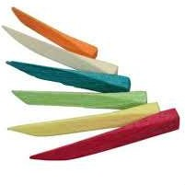
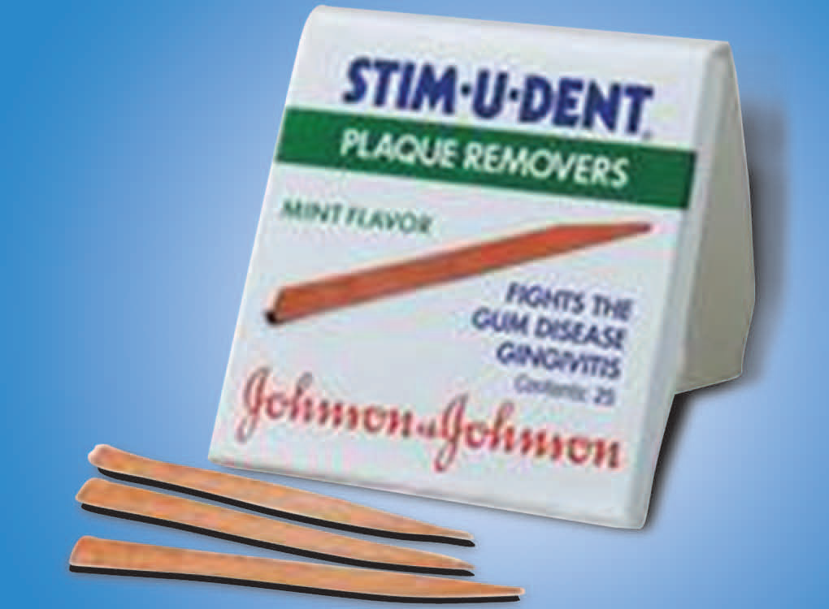
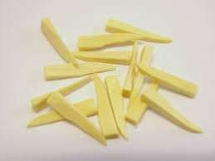
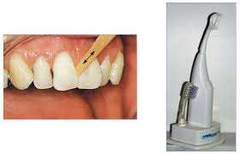
Wooden tips
used with or without a handle
Soft triangular wooden tips such as a stemu dent are placed in interdental spaces.
Made up of bass wood or balsa wood
Use limited to facial surfaces

Slide 15
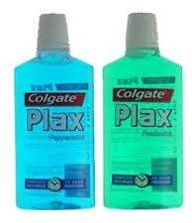
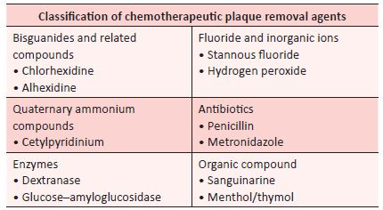
Chemical plaque control
ADA has accepted two agents as plaque control agents
Prescription chlorhexidine rinse
Non prescription essential oil rinse

Slide 16
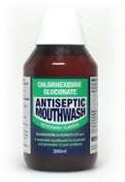
Chlorhexidine gluconate(0.2%)
Primary agent for chemical plaque control
Cationic bisbigunide which is effective against array of microorganism(gram positive,negative, fungi, yeast,virus)
Exhibits both antiplaque and antibacterial property.
It is bacteriostatic at low concentration and bacteriocidal at high concentration.

Slide 17
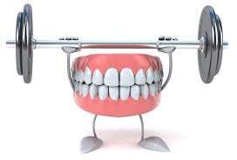
Mechanism of action
The bacterial cell is negatively charged so cationic chlorhexidine molecule is rapidly attracted to negatively charged bacterial cell surface.
This alters integrity of bacterial cell membrane
Chlorhexidine attracted towards innercell membrane

Slide 18
It binds to phospholipids on inner membrane
Increased permeability of inner membrane
Leakage of low molecular weight component such as potassium
Exhibits antimicrobial action

Slide 19
Prevents pellicle formation
Prevents adsorption of bacterial cell wall on to tooth surface
Prevents binding of mature plaque

Slide 20
Adverse effects
Brownish staining of teeth
Loss taste sensation
Stenosis of parotid duct
Oral mucosal erosion

Slide 21
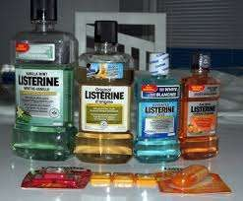
Essential oil
Oldest form of mouthwash.
Most popular one is listerine
Combination of phenol related essential oil,thymol and eucalyptol mixed with menthol and methyl salicylate.
It has shown plaque reduction in range 20-34% gingivitis reduction 20
-34%

Slide 22
Mechanism of action
Cell wall disruption and inhibition of bacterial enzymes
Adverse effects
Intial burning sensation and bitter taste in mouth

Slide 23
Quaternary ammonium compounds
Commonly used are cetylpyridinium chloride at 0.05%.
Cationic and binds to oral tissues but not strong as bisbiguanide.
When used orally they bind strongly to plaque and tooth surface but are released from binding site rapidly
Mechanism of action
Ability to rupture the cell wall and alter cytoplasmic contents.

Slide 24
Adverse effects
Yellow brownish discoloration of tongue and gingival margin of tooth
Burning sensation
Occasional desquamation

Slide 25
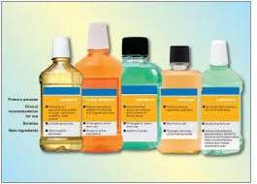
Sanguinarine
Used both mouth wash and tooth paste
Alkaloid extract from blood root plant sangunialic cancidense
Contain the extract at 0.3 and 0.2 zinc chloride
Adverse effect burning sentation
Helps in plaque reduction and reduction in gingivitis

Slide 26
Enzymes
Active agents
They can break already formed matrix of plaque and calculus
Eg mucinax

Slide 27
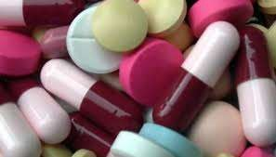
Antibiotics
Antibiotics such as vancomycin,erythromycin,nidamycin and kanamycin has used for plaque control.
However due potential problem of bacterial resistance and hypersensitivity reaction use of theses agents have been reduced considerably.

Slide 28
Take away home messageae
Home dental care should begin in infancy.
Usually a soft nylon bristle ,rounded,multi-tuffled with a long neck is preferred.
Powdered brushes are preferred choice in disabled children.
For people who can not grasp and hold brush handle is attached to Velcro strap on the palm.

